Slide 1
Social media metrics

Slide 2
Description
Use analytics tools to track and analyze social media performance. Identify trends, strengths, and areas for improvement.
Steps to Implement:
1. Define Key Performance Indicators (KPIs)
Engagement Metrics: Track likes, shares, comments, and interaction rates.
Reach & Impressions: Number of unique users reached and the total number of views (impressions).
Conversion Metrics: Monitor click-through rates (CTR), website traffic generated by social media, and sales conversions.
Follower Growth: Measure the growth rate of followers over time.
Content Performance: Identify which posts generate the most interaction (photos, videos, stories, etc.).

Slide 3

Utilize analytical tools
Native Platform Analytics: Tools like Facebook Insights, Instagram Insights, Twitter Analytics, and LinkedIn Analytics provide detailed metrics about performance.
Google Analytics: Integrate your website with Google Analytics to track traffic, conversions, and user behavior from social media referrals.
Third-Party Tools: Tools like Hootsuite, Sprout Social, or Buffer offer detailed tracking and reporting features.
3. Track and Monitor Metrics Regularly
Set up a dashboard that allows you to monitor KPIs in real time.
Analyze data over different periods (daily, weekly, monthly) to identify patterns.

Slide 4
Analyze trend
Content Trends: Look for posts that perform well in terms of engagement and reach. Identify themes or topics that resonate with your audience.
Audience Behavior: Study the demographics, peak interaction times, and device usage to optimize your posts.
Engagement and Conversion Trends: Check the relationship between engagement and conversions. High engagement should correlate with traffic, leads, or sales.
5. Identify Strengths and Areas for Improvement
Strengths: Identify content types or strategies that are performing well (e.g., high engagement rates, positive user feedback).
Weaknesses: Spot areas where engagement drops, or certain social platforms aren’t yielding results.
Improvement Areas: Modify underperforming content and consider adjustments in posting time, content style, or targeting strategy.

Slide 5
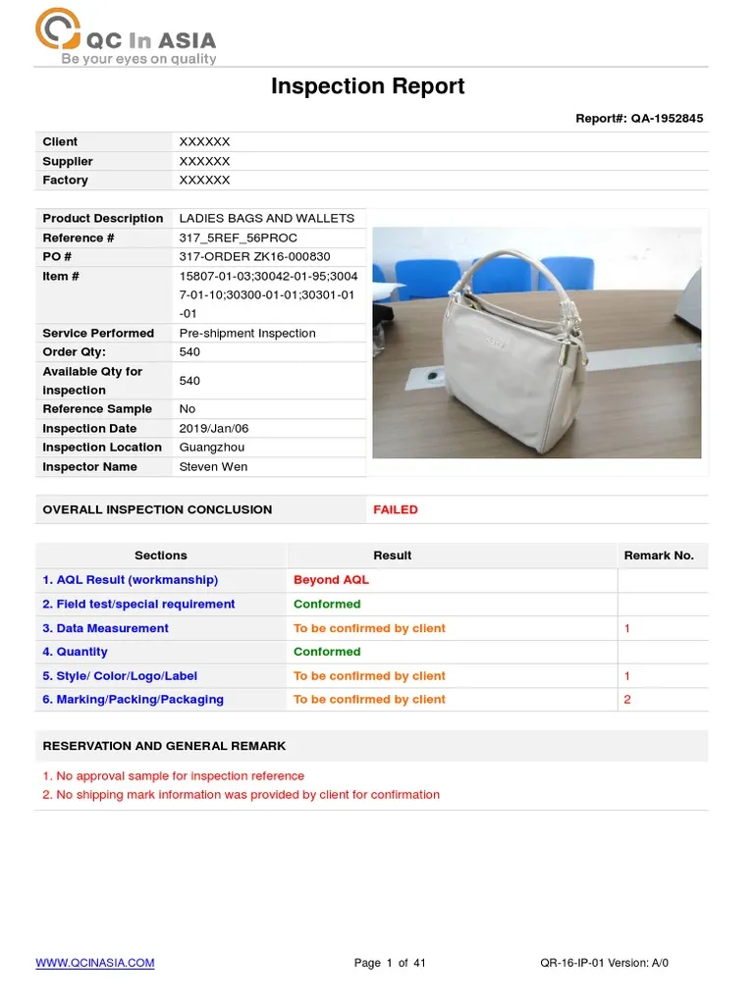
Testing and reporting
Test different strategies to see what resonates best. Change variables like post types, hashtags, or target audiences, and compare results.
Use the insights from these tests to continuously refine your strategy.
7. Reporting and Review
Monthly or quarterly reports: Summarize your social media performance, highlighting key metrics and trends.
Adjust strategy: Based on data, pivot strategies to focus on areas that drive results and address weak points.

